Slide 1


FINAL PROJECT Exploring TIC and Related Technologies
Welcome to an exciting journey into the world of TIC (Information and Communication Technologies) and its various related technologies. We’ll take a quick look at systems and network

Slide 2
The content of the presentation
introduction
Overview of TIC
conclusion
google
microsoft
Git and github

Slide 3

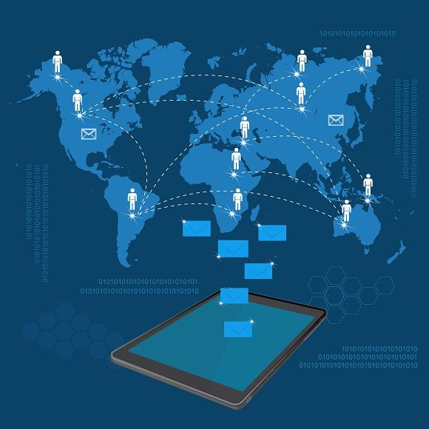
introduction
ThIS PRESENTATION introduces a project that explores TIC and its impact on our daily lives, highlighting key players like Google and Microsoft. It emphasizes TIC's role in digitization and invites readers to join in exploring the present and future of digital connectivity.

Slide 4




Overview of TIC and Related Technologies
The TIC as a connecting thread in our digital world, enabling us to communicate and learn such as GOOGLE , MICROSOFT , GIT and GITHUB … . The TIC has tools that we can use for various activities. That's why we made our digital life easier.

Slide 5
GOOGLE
Google offers a suite of services such as Gmail, Drive, Docs, Sheets, Slides, Meet This is what made it several features and many use cases
v v
v

Slide 6
microsoft
Microsoft's tools, like Office Suite, Teams, OneDrive, SharePoint, and Outlook, cater to diverse user needs for productivity and workflows. These tools offer seamless integration for a superior user experience
;

Slide 7

Git and github
Git and GitHub is for version control, such as tracking project versions, facilitating team collaboration, and correcting mistakes. GitHub is also noted as a social tool for global programming collaboration.

Slide 8
conclusion
The presentation briefly summarizes the role of TIC tools in a digital landscape that values efficiency and collaboration. It highlights popular tools such as Google services, Microsoft tools, Git and GitHub. The presentation concludes by emphasizing the importance of efficient TIC utilization in enhancing communication and innovation

